Slide 1
Addressing cadmium challenges in cocoa trade: Insights and Lessons from two STDF projects in Latin America and the Caribbean
Key findings, lessons learnt, and recommendations from the independent evaluation of projects STDF/PG/577 and STDF/PG/681
6th November 2025

Slide 2
Context
Market access risk: EU/global Cadmium (Cd) limits put pressure on exporters - especially LAC.
STDF response: Two projects (PG/681, PG/577) upgraded labs, aligned SOPs, mapped hotspots, and scaled farmer training.
Core takeaway: These projects successfully managed Cd-related trade risks

Slide 3
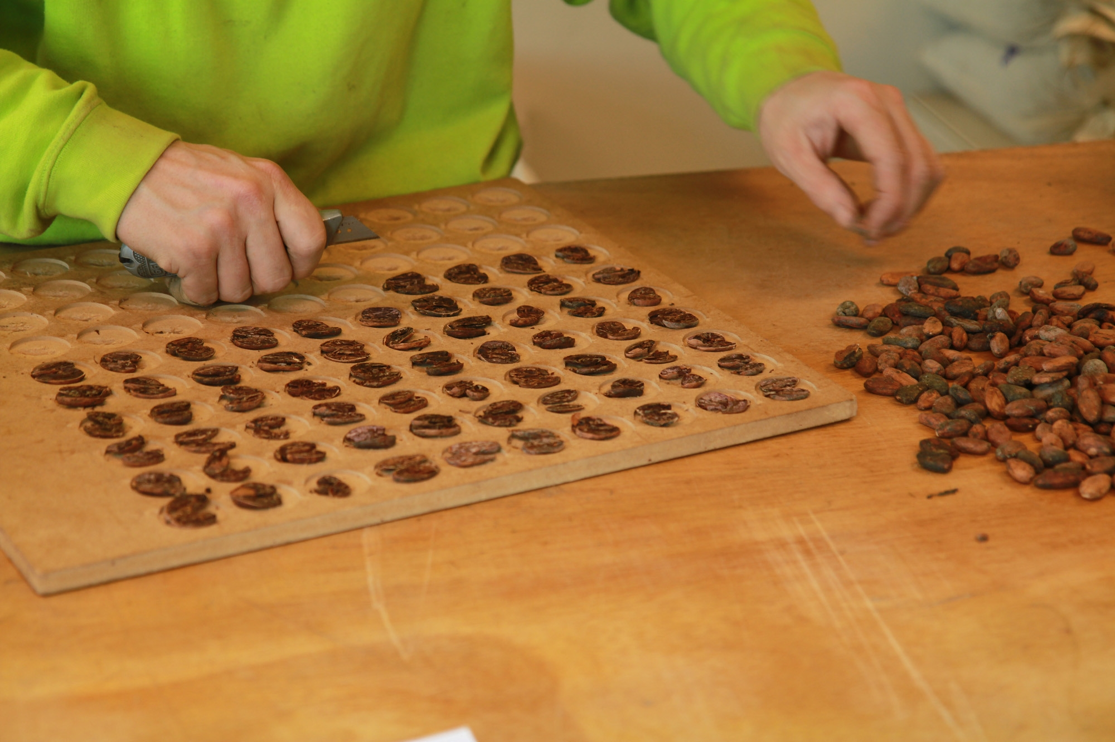





STDF/PG/681
Improving the institutional capacity of Colombia and Ecuador to mitigate trade barriers due to the high cadmium levels in cacao
Time frame
01/09/2020 – 31/12/2024
Project Value
US$617,999
Project results
Laboratory QA/QC: ring tests conducted in 25 labs; SOPs, manuals, and curricula produced; national and private labs strengthened.
Mapping: hotspot maps created/expanded - now guide sourcing, blending, and planting decisions.
Technology: portable XRF introduced, enabling faster, lower-cost in-country screening and reducing reliance on foreign testing.
STDF Contribution
US$516,989
Implementer
KU Leuven
Beneficiaries
Colombia, Ecuador

Slide 4
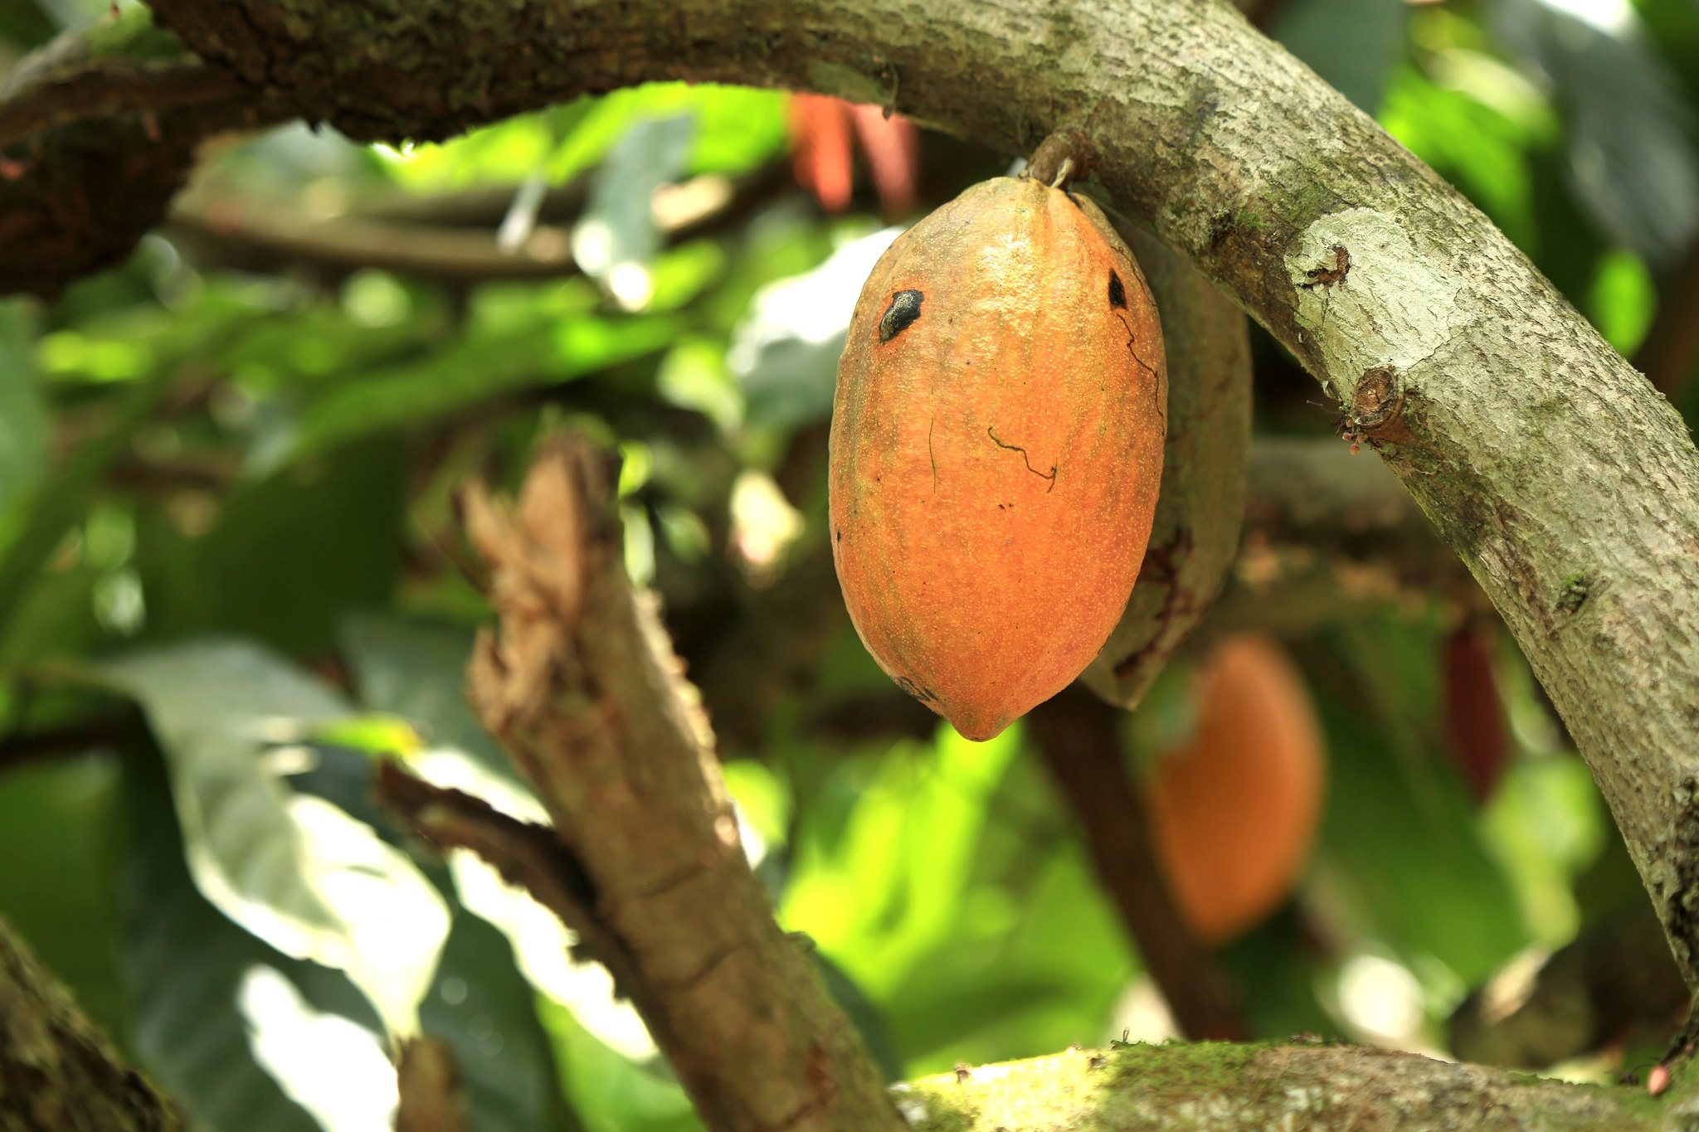
STDF/PG/577
Improving Capacity Building and Knowledge Sharing to Support Management of Cadmium Levels in Cocoa in Latin America and The Caribbean for Export to the EU
Time frame
01/02/2022 – 30/09/2025
Project Value
US$814,119
Project results
Regional coordination: regional platform developed & SOP consensus reached for Cd analysis.
Mapping: hotspot maps updated; fertilizer identified as a key Cd source.
Capacity building: 30 Master Trainers trained; 2,300+ farmers reached.
Policy integration: 9 recommendations integrated into national cocoa plans (e.g., Peru; updates planned in others).
STDF Contribution US$381,946
Implementer
The Inter-American Institute for Cooperation on Agriculture (IICA)
Beneficiaries Colombia, Ecuador, Peru and Trinidad and Tobago

Slide 5
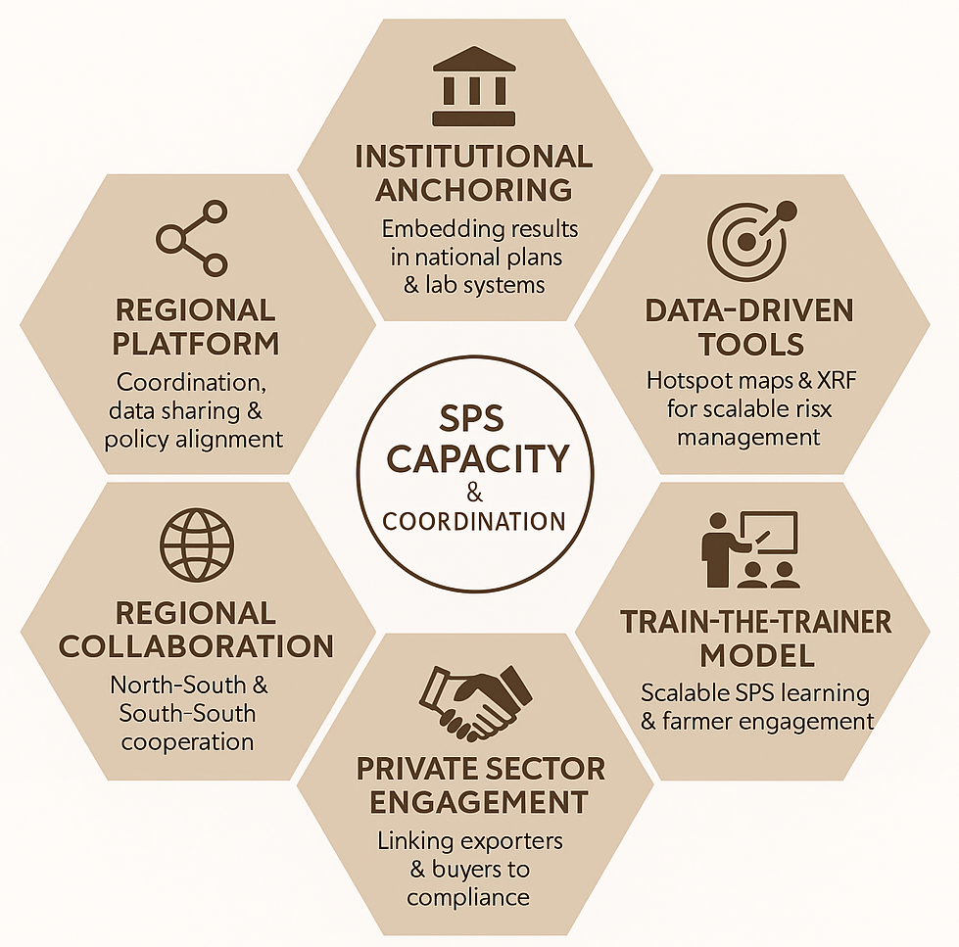
Lessons Learned

Slide 6
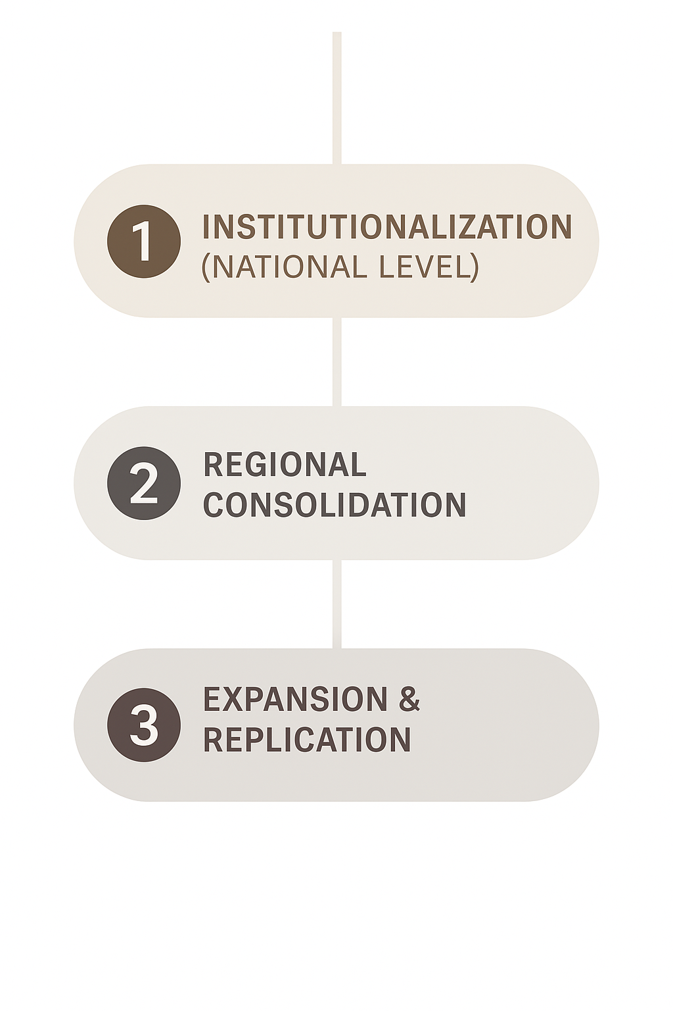
Key takeaways
Cd monitoring to be led by national institutions
Scale proven tools (mapping, XRF)
Continued regional coordination
Extend to other regions
Apply model to other contaminants & commodities

Slide 7

With thanks to STDF donors and other partners

Slide 8
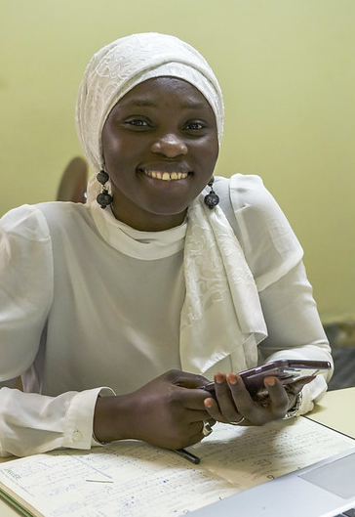




Find out More
Explore our website: www.standardsfacility.org
Follow us on LinkedIn: @ Standards and Trade Development Facility
Sign up for our newsletter: https://standardsfacility.org/newsletter
Subscribe to our YouTube Channel: @STDFvideos

